Slide 1
Image Quilting
Svitlana Morkva,
Tal Rastopchin,
Ivan Sobko,
Baptiste Goumain

Slide 2
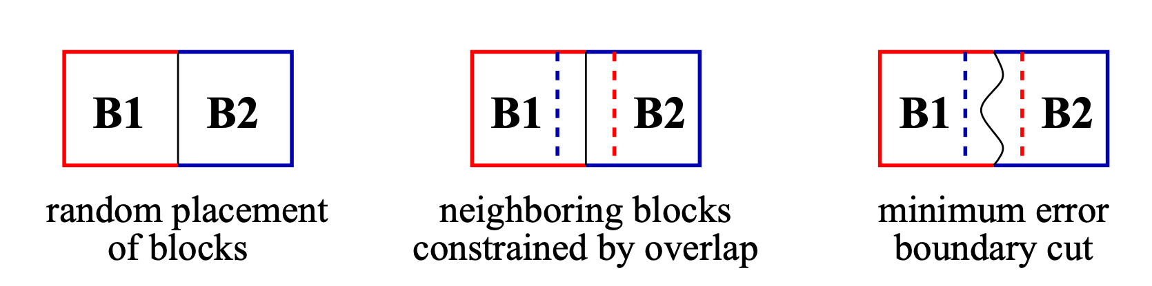
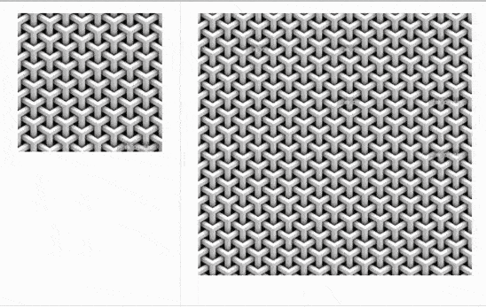
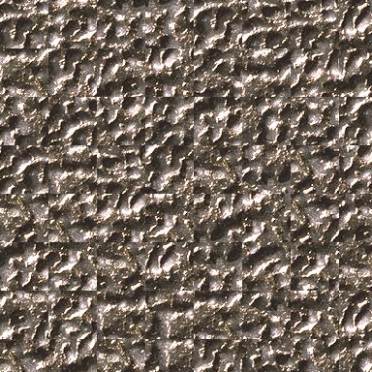
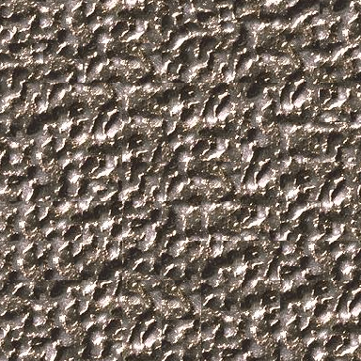
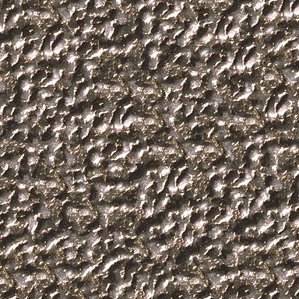
Algorithm
Different methods:
Random Block Sampling
Overlap Sampling & Best Match
Minimum Error Boundary Cut
Different results:
Notes:
Our implementation was written from scratch based on the original paper. We implemented our algorithm by expanding from the most naive method - Random Block Sampling, to more advanced ones - Overlap Sampling & Best Match, and finally to the Minimum Error Boundary Cut. Random Block Sampling
This is the easiest method of texture synthesis that simply chooses random blocks and just straightforwardly stitches them together. Usually, stitches are going to be very obvious and won't create a nice pattern.
Overlap Sampling & Best Match
In this part, we choose some random block for the top left corner. After that, we are trying to overlap all possible blocks with the output image with the offset.. For the received overlap region we calculate the L2 loss function. After that, we are finding the block with the minimum error, using this error we can randomly select one suitable block that we stitch together with the image in the middle of the overlap region.
Minimum Error Boundary Cut
For this most advanced algorithm, we are doing all the same steps as for the Overlap Sampling & Best Match, when selecting the most suitable block. The only difference is the stitching method. In this case, instead of just connecting blocks in the middle of the overlap region, we are finding the best possible path of stitching using dynamic programming.

Slide 3


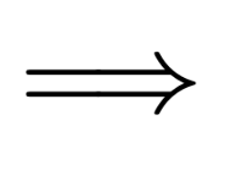
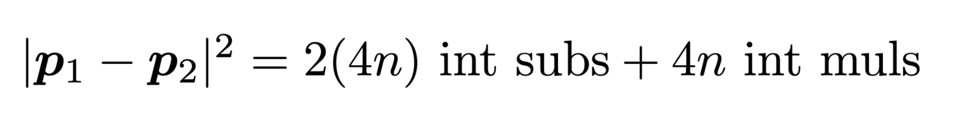
Cost Analysis & Baseline Implementation
Cost Function
Input: n pixels
Asymptotic runtime: O(n^3)
85.56% Pixel L2 Norm
3.09% Minimum Cut + Block Write
11.35% Other
Notes:
To measure performance we chose the cost metric of ints/cycle. To count it we derived general formula for each block, as we iterate through blocks variable will update the total count of flops.
The major bottleneck in our code is the ComputeOverlap function that estimates the L2 loss function for all possible blocks in all possible positions. By performing profiling analysis with “perf” tool, we can see that ComputeOverlap takes from ~85%(on small images) to 98%(on big images) of all algorithm computations. To address this issue we focused mainly on improving this function, which will be discussed further.

Slide 4
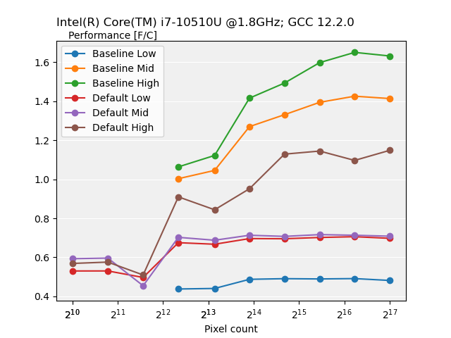
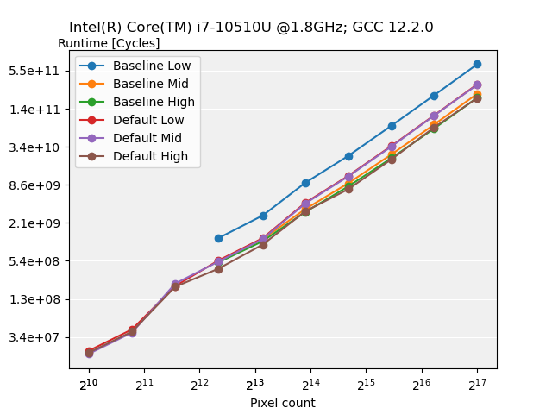
Initial Implementation and Benchmark
Notes:
#NOTE: if there will be plot on right side - add some notes about that plot

Slide 5
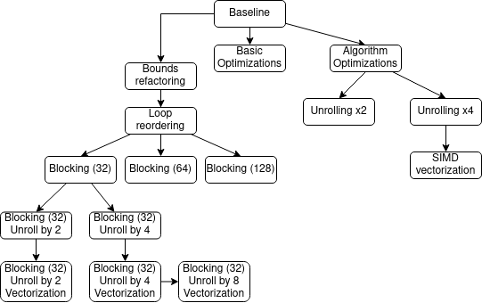
Optimization Plan
Standard
Algorithm
Vectorization
Blocking
Notes:
To remove or at least reduce the bottleneck various optimizations were attempted.
Simple Optimizations (right side of the tree)
We started with simple optimizations like pre-calculation of indices and bounds, loop unrolling with scalar replacement and optimization of dependencies / ILP for computing the overlap error and in computing the minimum cuts. For vectorization we used different intrinsics and load 16 values at once (4 pixels, each pixel is RGBA). For each optimization we calculated latency for each operation and reordered them to minimize idle cycles.
Advanced Optimizations
Bounds refactoring: the original compute overlap function computed the overlap region bounds for every potential source block. We can compute this exactly once as the output overlay region remains constant while iterating over all potential source blocks.
Loop reordering and blocking: computing the overlap reuses the output overlap region as well as the entire input multiple times. We can try to address this temporal locality by loop reordering to first keep the entire output overlap region in cache and then blocking to keep as much of the input in cache as we can.

Slide 6
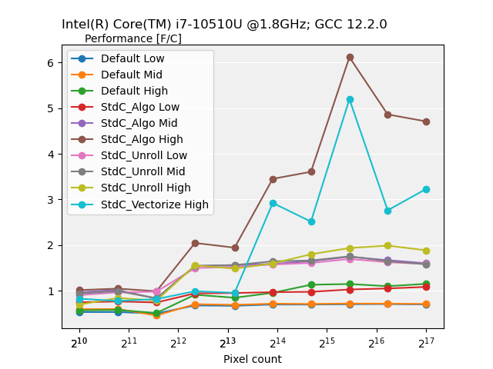
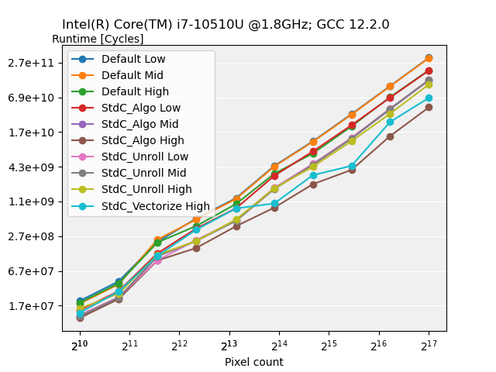
Initial Optimizations

Slide 7
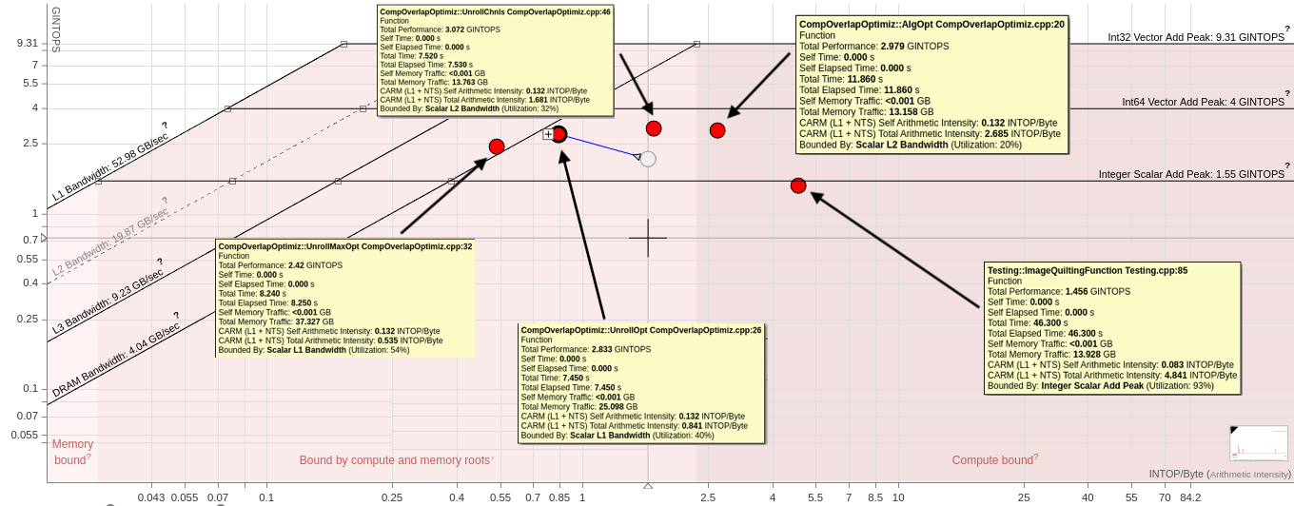
Memory Bounded
Notes:
The rightmost red dot is the default implementation. All of our further optimization decrease the operational intensity and push it to the left, leaving us memory bounded.

Slide 8
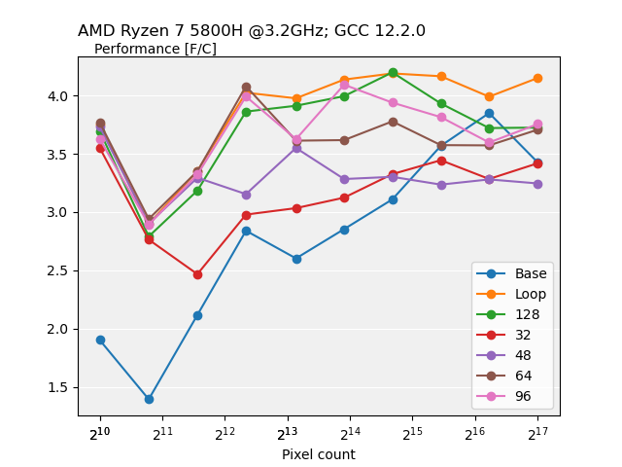
Addressing the Memory Bound
Change loop order
Standard C, K unrolling, bounds refactoring
Blocking variants
-O3 -ffast-math -march=native

Slide 9
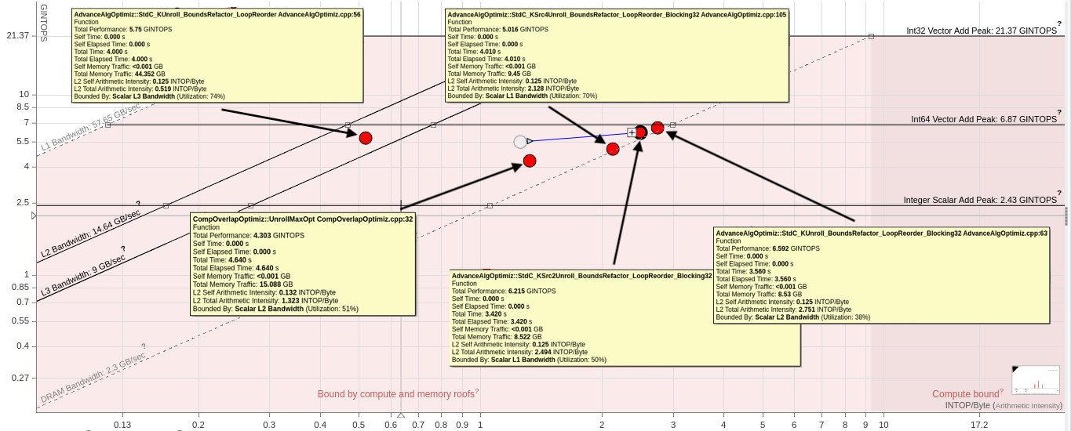
Addressing the Memory Bound

Slide 10
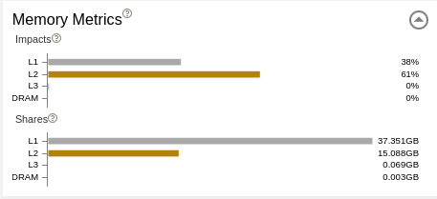
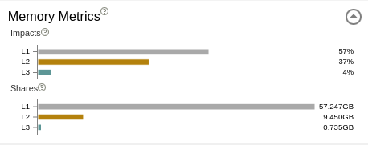
Blocking impact on cache usage
Unroll by 4
Unroll by 4 + Blocking

Slide 11
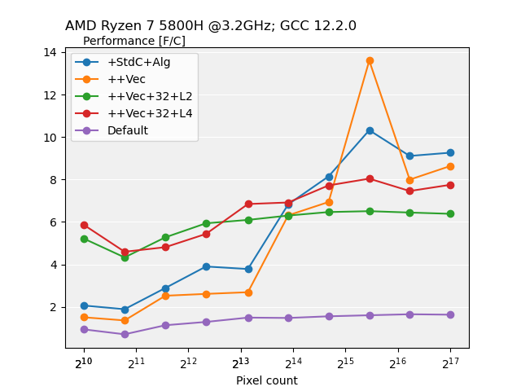
Best Performances
🥇 5.66x: Standard C, Algorithm
🥈 5.23x: + Vectorization
🥉 4.64x: + Vectorization, 4x loop unrolling, 32 x 32 pixel blocking
Standard C, Algorithm
Default implementation
-O3 -ffast-math -march=native

Slide 12
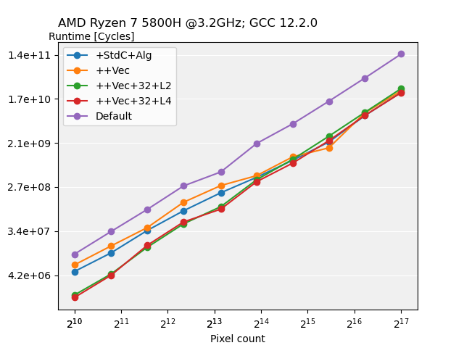
Best Runtimes
🥇 6.19x: + Vectorization, 4x loop unrolling, 32 x 32 pixel blocking
🥈 6.08x: Standard C, Algorithm
🥉 5.67x: + Vectorization
Default implementation
Vectorization, 4x loop unrolling, 32 x 32 pixel blocking
-O3 -ffast-math -march=native

